Slide 1

Image generation with diffusion models
Attila Nemes (B6RYIK), Csaba Potyok (OZNVQ4)

Slide 2
Agenda
review of literature (tutorial video watching)
acquisition and preparation of datasets (Flowers102, CelebA)
baseline model (VAE)
designing and training a DDPM model
evaluation of the results
creating an AI service

Slide 3
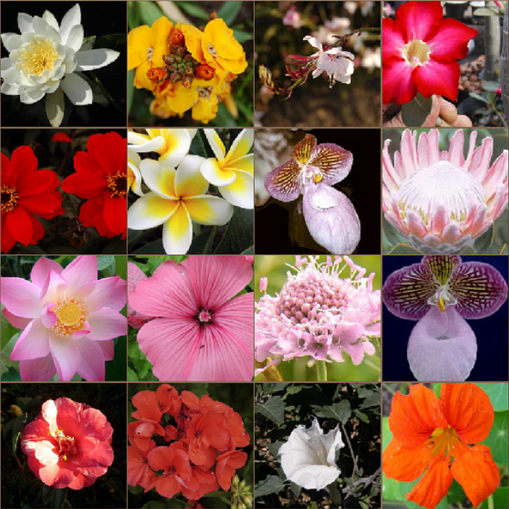
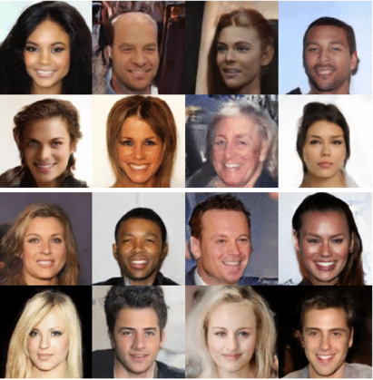
Datasets
Flowers102 (~8k images)
CelebA (~200k images) (source: https://huggingface.co/datasets/nielsr/CelebA-faces)

Slide 4
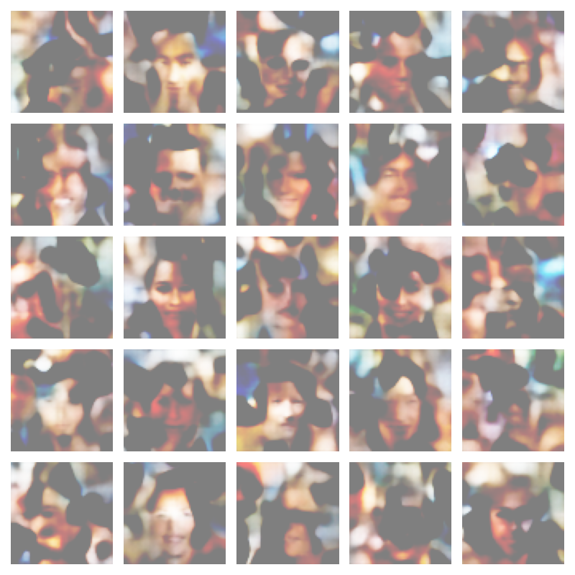
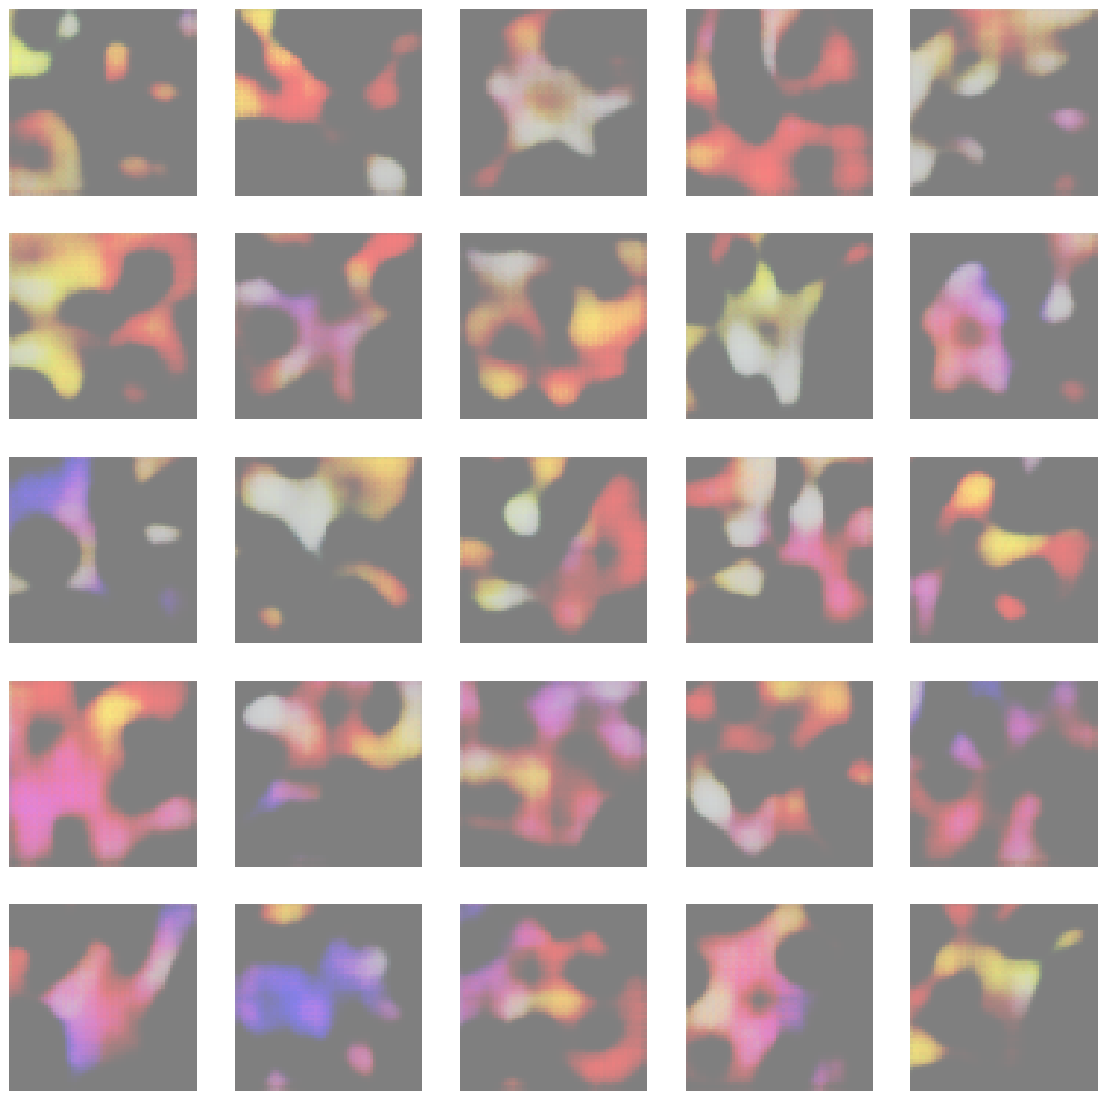
Baseline model
simple VAE
10 epoch training
no hyperparameter optimization

Slide 5
DDPM architecture
BatchNorm2D
ReLU
Conv2D
Conv2D
ReLU
Conv2D
Add
BatchNorm2D
SinusiodalPositionEmbedding
Linear
ReLU
Upsampling Block
Conv2d
Conv2d
Downsampling Block
Downsampling Block
Upsampling Block
Downsampling Block
Upsampling Block
BatchNorm2D
ReLU
Downsampling Block
Upsampling Block
Conv2D
ConvTranspose2D
ReLU
Conv2D
Add
BatchNorm2D
SinusiodalPositionEmbedding
Linear
ReLU

Slide 6
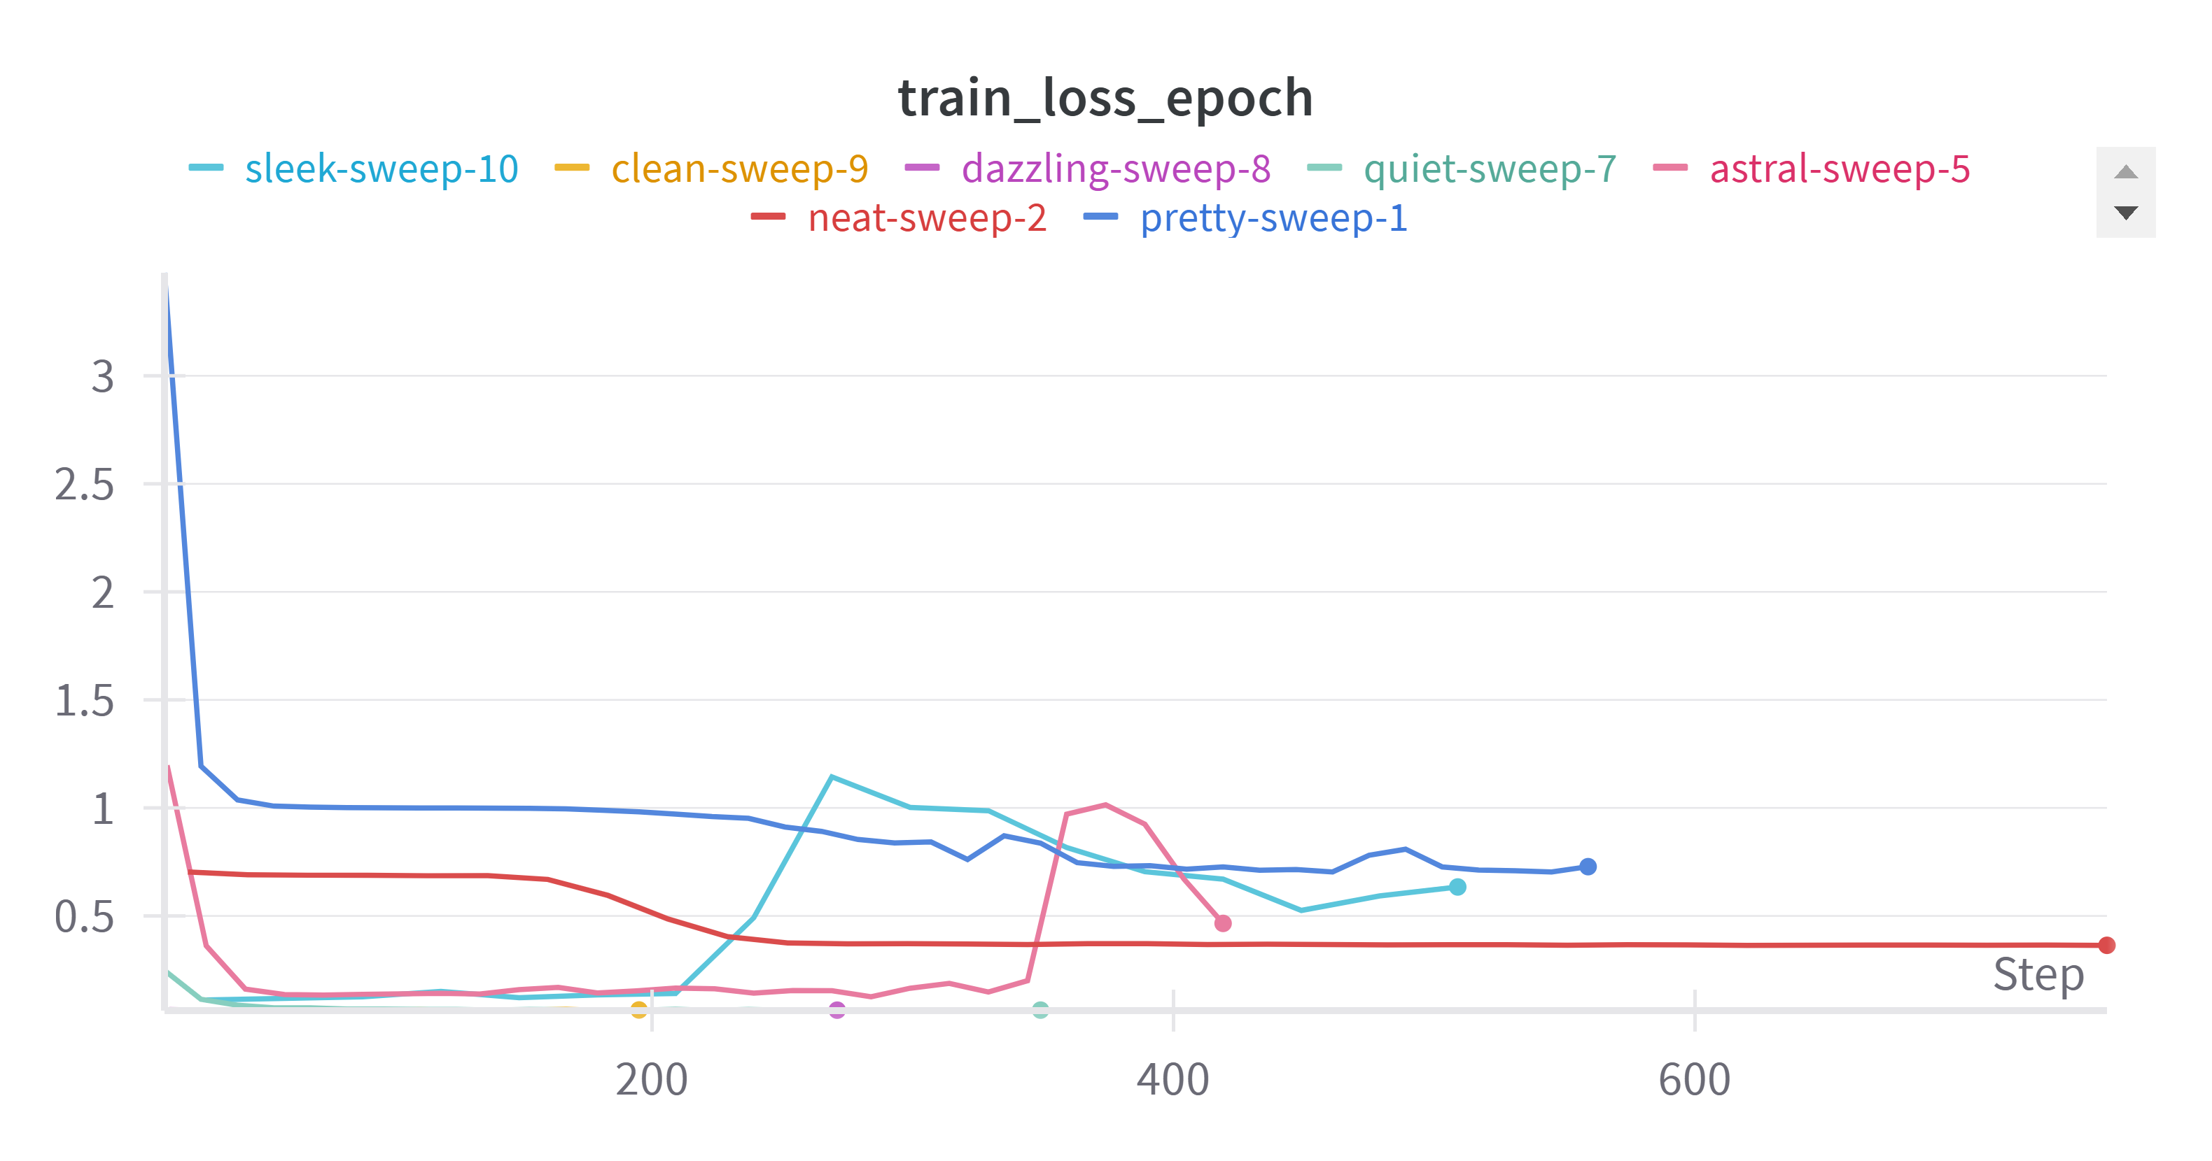
Training models
using Pytorch + Ligthning
LightningModule for pipeline
Diffusion model
running on Komondor

Slide 7
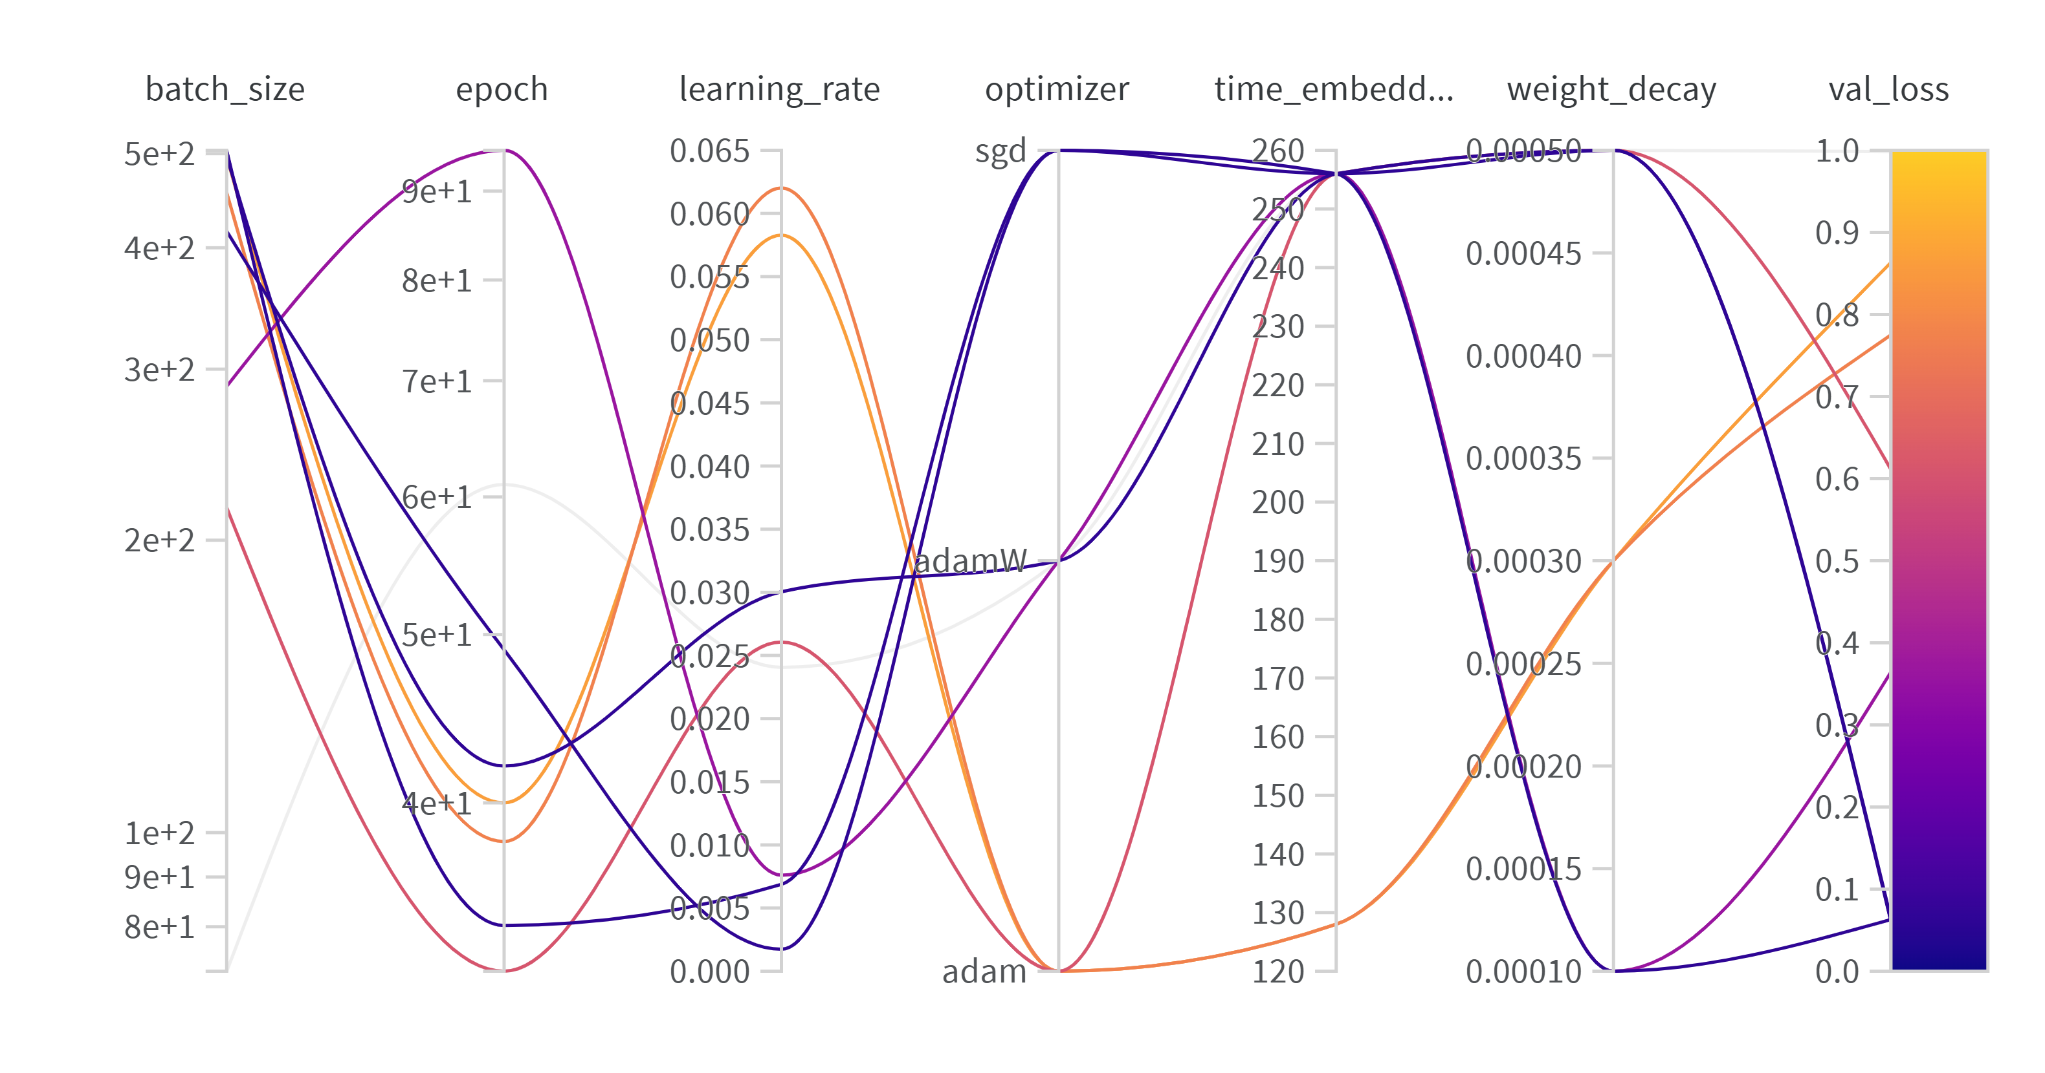
Hyperparameter optimization
using wandb
Bayesian hyperopt
for both datasets
running on Komondor

Slide 8
Evaluation of models
model | FID | IS mean | IS std | loss
1 | 60,68 | 1,328 | 0,021 | 0,057
2 | 19,33 | 1,527 | 0,026 | 0,059
3 | 100,41 | 2,485 | 0,123 | 0,055
4 | 17,958 | 1,579 | 0,054 | 0,062
5 | 14,353 | 1,738 | 0,063 | 0,065
6 | 15,57 | 1,562 | 0,029 | 0,077
7 | 8,477 | 1,628 | 0,048 | 0,067
8 | 25,804 | 1,7 | 0,048 | 0,073
model | FID | IS mean | IS std | loss
1 | 26,072 | 1,568 | 0,006 | 0,04
2 | 18,794 | 1,186 | 0,003 | 0,037
3 | 16,499 | 1,605 | 0,008 | 0,041
4 | 16,39 | 1,374 | 0,0048 | 0,039
5 | 16,606 | 1,349 | 0,003 | 0,038
Result on CelebA
Result on Flowers102

Slide 9
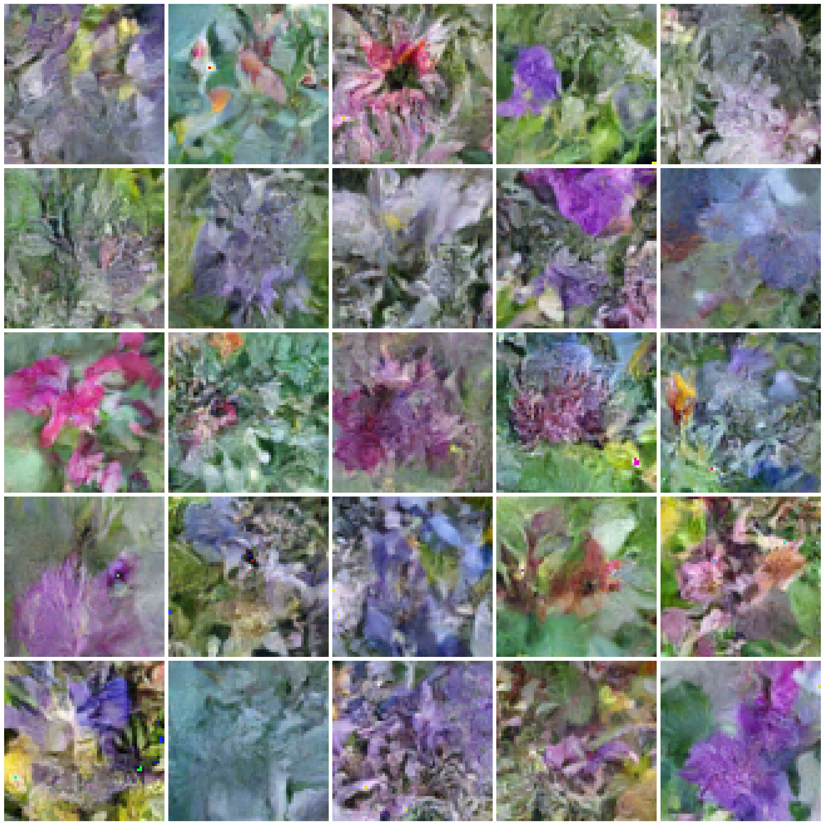
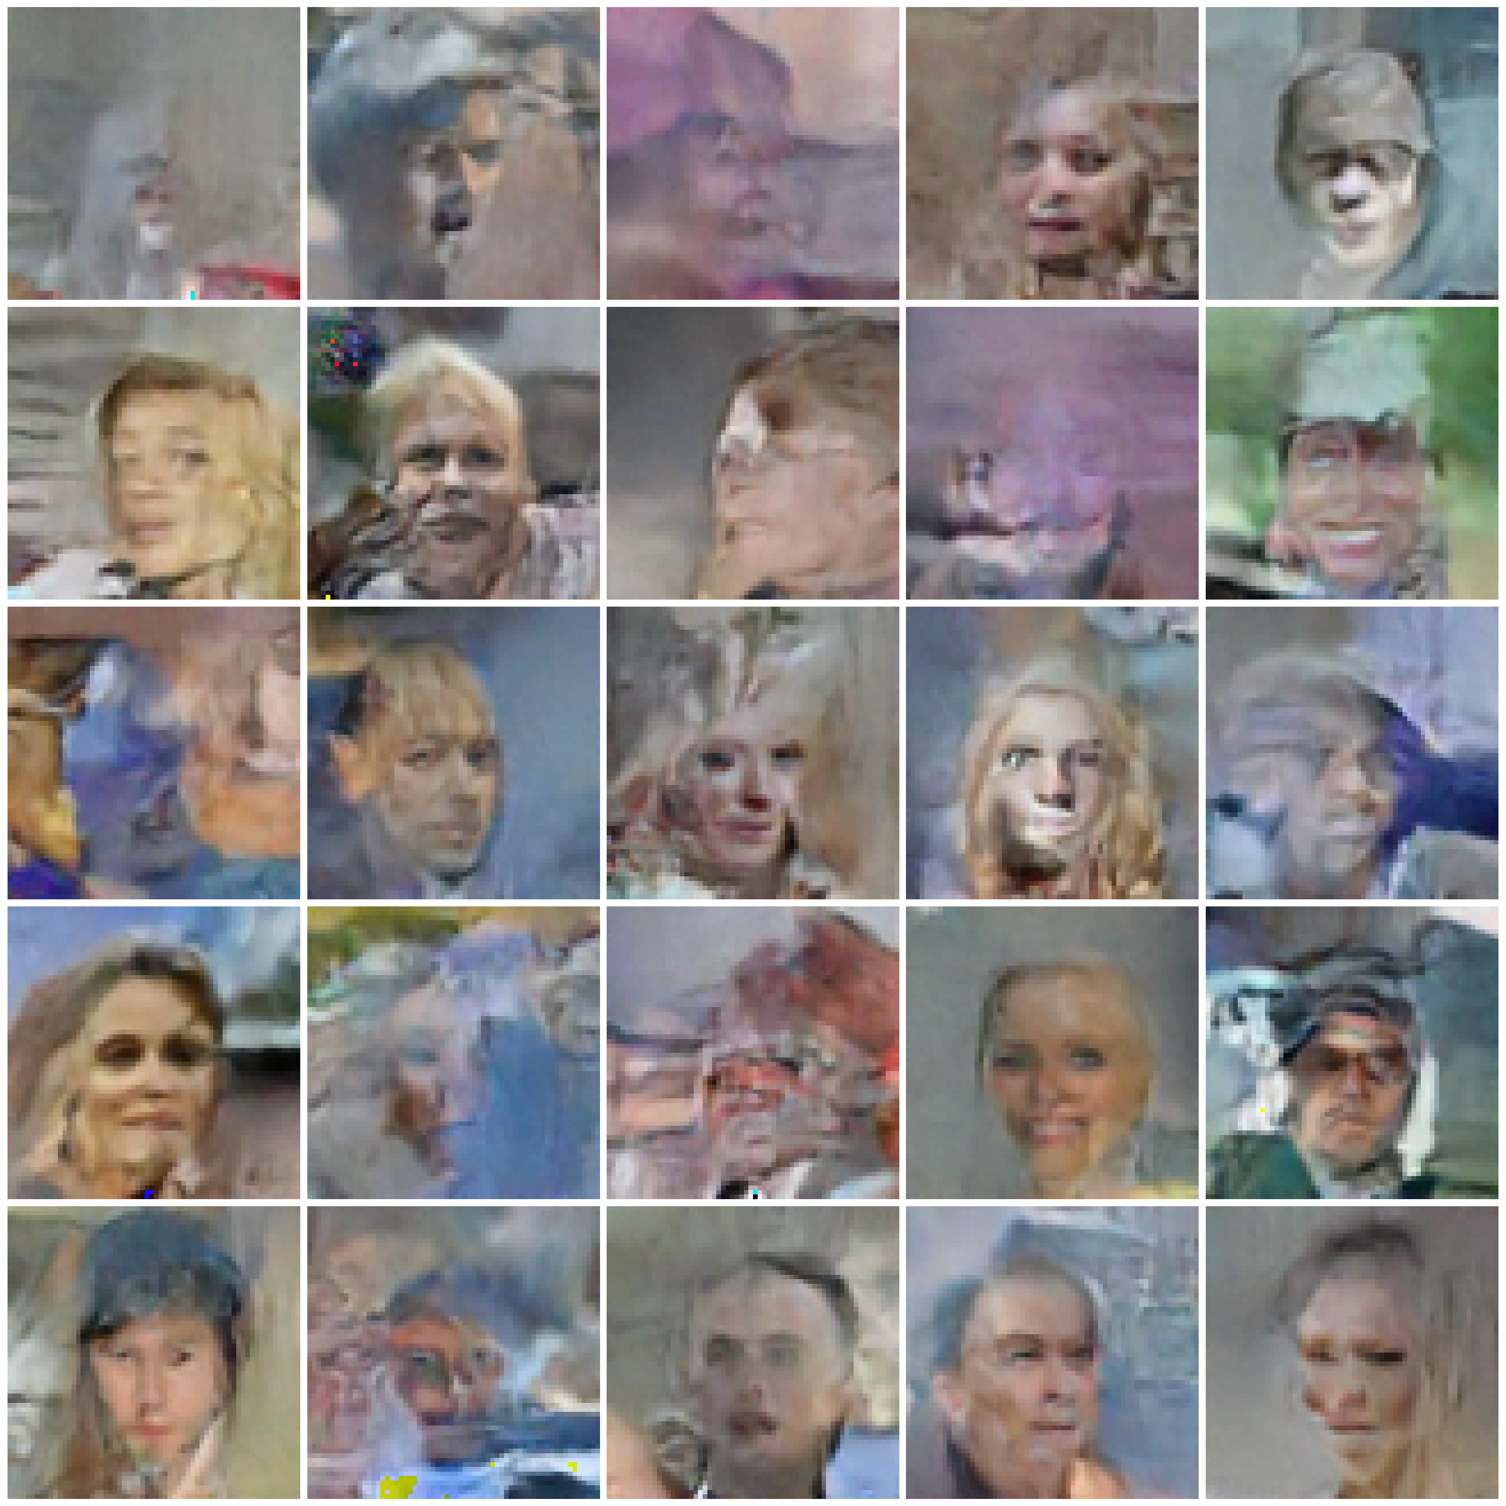
Generated images
Best with Flowers102
Best with CelebA

Slide 10
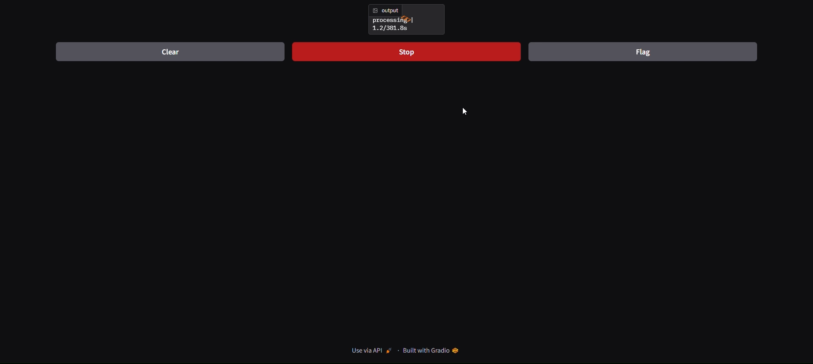
Demo video

